Slide 1



CALL CENTER
Operations
Preet Jain
Aakanksha Pote

Slide 2

Content
01
Ambition Of Problem
02
Innovation Of Solution
03
Societal Impact
04
Creativity / Wow Factor
05
Achievements
06
Future Goals
07
Team

Slide 3

Ambition
Our ambition is to transform call centre operations using Speech-to-Text (STT) and Text-to-Speech (TTS) technologies.
We aim to provide 24/7 support with accurate query transcription and prompt, natural-sounding responses.
By integrating these technologies, we optimize workforce management, fostering a culture of excellence and ensuring unparalleled customer service.

Slide 4
Innovation of Solution
Seamless integration of cloud-based Speech-to-Text (STT) and Text-to-Speech (TTS) APIs.
Access to reliable and scalable technology without the need for extensive infrastructure investment.
Streamlined implementation process with minimal setup time.
Real-time data synchronization for accurate query handling.
Flexible and customizable solutions adaptable to changing business needs.
Utilizing integrated cloud APIs for efficient call centre operations.

Slide 5

Revolutionizing Customer Service Experience
Empowering customers with seamless access to support services.
Enhancing inclusivity by providing accessible communication channels.
Improving customer satisfaction through faster query resolution.
Contributing to environmental sustainability by reducing hardware requirements.

Slide 6



Wow Factor
Dynamic voice interactions through cloud-based TTS technology.
Effortless transition between speech and text channels for user convenience.
Integration with existing call centre systems for enhanced productivity.
Cost-effective solution without compromising on quality or innovation.
Sales

Slide 7
Quality of Presentation
Visual Design:
Clear and concise slide layouts with emphasis on key information.
Utilization of branding elements to maintain consistency and professionalism.
Relevant graphics and visuals to enhance understanding of the solution.
Engaging Stakeholders with a Compelling Presentation
Content Delivery:
Engaging narrative to illustrate the value proposition of integrated cloud APIs.
Concise communication of features and benefits tailored to audience needs.
Opportunities for audience interaction and feedback.

Slide 8
CONCLUSION
In conclusion, our ambition to transform call center operations through STT and TTS technologies represents a significant leap forward in customer service. By providing round-the-clock support with accurate and natural responses, we not only enhance efficiency but also elevate the customer experience to new heights. This initiative reflects our commitment to excellence and innovation in customer service.

Slide 9


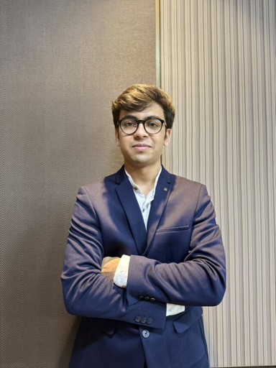


Our Team
Aakanksha Pote
Preet Jain
Manager

